Slide 1


GIT Commands
R.M.D. ENGINEERING COLLEGE
22CS102
SOFTWARE DEVELOPMENT PRACTICE

Slide 2
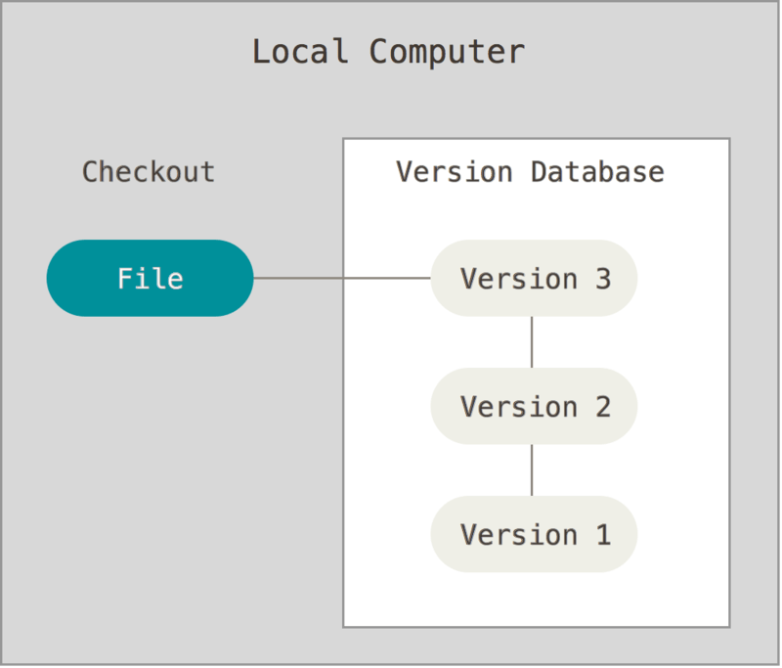
GIT
Version control is a system that records changes to a file or set of files over time so that you can recall specific versions
Local Version Control Systems
ISSUE need to collaborate with
developers on other systems.

Slide 3
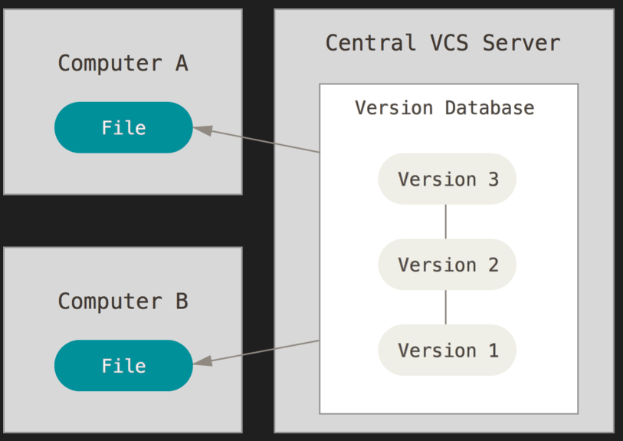
Centralized Version Control Systems
ISSUE
single point of failure

Slide 4
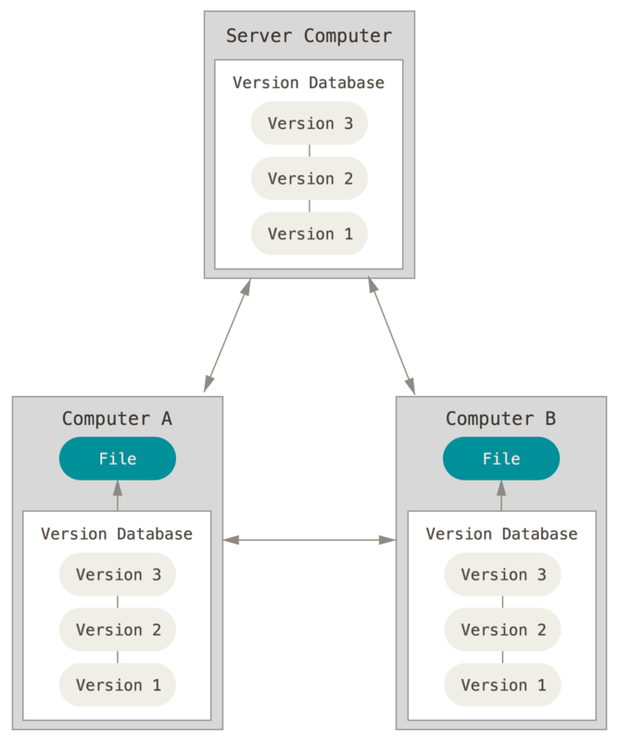
Distributed Version Control Systems
Git is a distributed version control system clients don’t just check out the latest snapshot of the files; rather, they fully mirror the repository, including its full history.
Thus, if any server dies, and these systems were collaborating via that server, any of the client repositories can be copied back up to the server to restore it. Every clone is really a full backup of all the data.

Slide 5
INTRODUCTION TO GIT
Git thinks of its data more like a series of snapshots of a miniature filesystem. With Git, every time commit, or save the state of the project, Git basically takes a picture of what all files look like at that moment and stores a reference to that snapshot. To be efficient, if files have not changed, Git doesn’t store the file again, just a link to the previous identical file it has already stored. Git thinks about its data more like a stream of snapshots.
ADVANTAGE OF GIT
No need to connect to central server
Can work without internet connection
No single failure point
Developers can work independently and merge their work later
Every copy of a Git repository can serve either as the server or as a client
Git tracks changes, not versions
Bunch of little change sets floating around

Slide 6
What is Repository
“repo” = repository
Usually used to organize a single project
The purpose of git is to manage a project, or a set of files, as they change over time. Git stores this information in a data structure called a repository
A git repository contains, mainly a set of commits
Repos can contain folders and files, images, videos, spreadsheets and data sets – anything your project needs

Slide 7
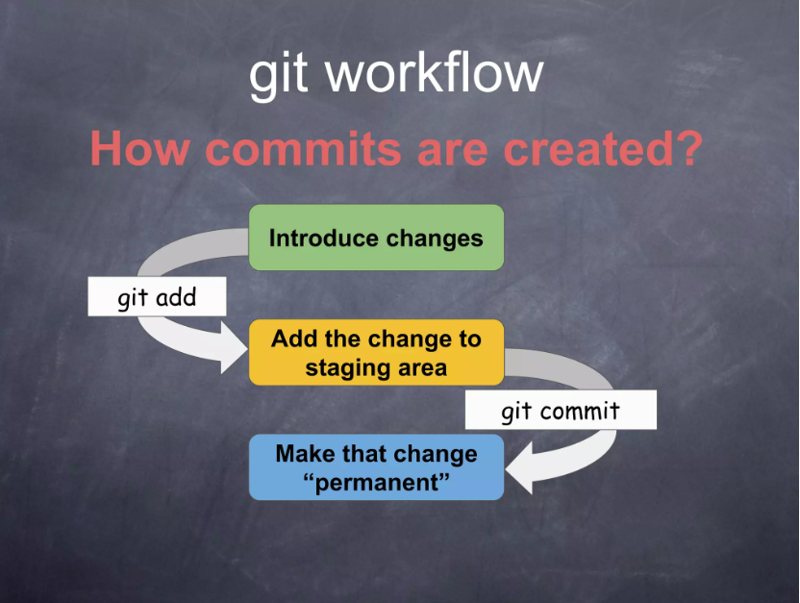
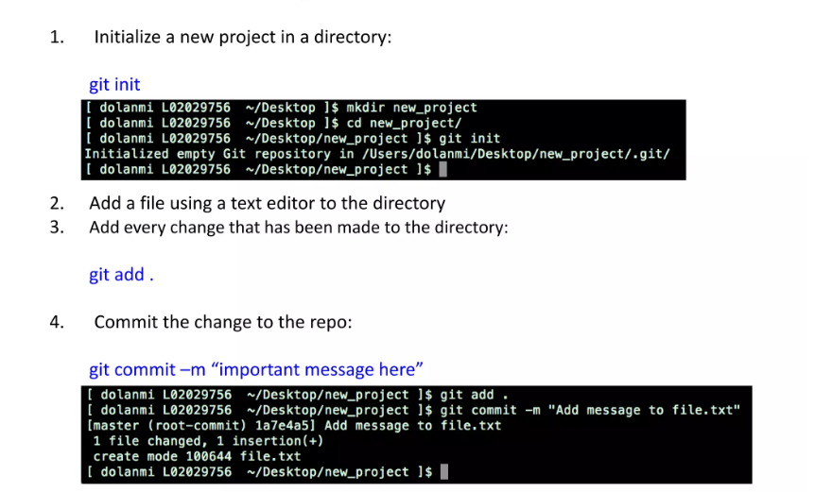
A simple Git workflow

Slide 8
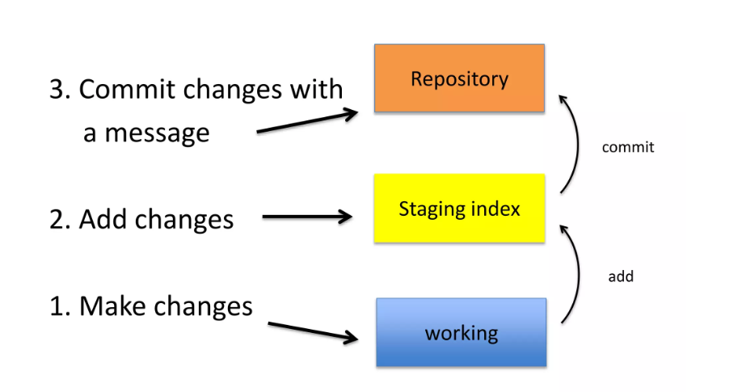
After initializing a new git repo…

Slide 9
A note about commit messages
Tell what it does (present tense)
Single line summary followed by blank space followed by more complete description
Keep lines to <=72 characters
Ticket or bug number helps
A commit object mainly contains three things
1. A set of changes the commit introduces
2. Commit messages describing the changes
3. A hash, a 40-character string that uniquely identifies the commit object

Slide 10
The HEAD Pointer
Points to a specific commit in repo
As new commits are made, the pointer changes
HEAD always points to the “tip” of the currently checked-out branch in the repo
Not to the working directory or staging index
Last stage of repo (what was checked out initially)
HEAD points to parent of next commit(where writing the next commit takes place)

Slide 11
GIT COMMANDS USED IN GIT BASH.EXE
cd command
cd command refers to change directory
SYNTAX : cd folder_name
ls command
ls command is used to list all the files and folders in the current directory.
SYNTAX: ls
1.Set your global username/email configuration
Open Git Bash and begin creating a username and email for working on Git Bash. Set your username:
git config --global user.name "FIRST_NAME LAST_NAME"
Set your email address:
git config --global user.email "MY_NAME@example.com"

Slide 12
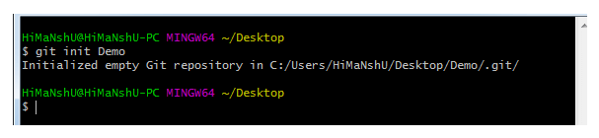
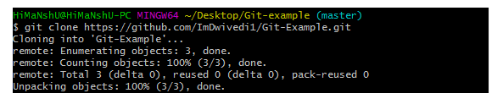
2. GIT INIT COMMAND
Initialize the local directory as a Git repository
git init
3) Git clone command
This command is used to make a copy of a repository from an existing URL. If I want a local copy of my repository from GitHub, this command allows creating a local copy of that repository on your local directory from the repository URL.
SYNTAX
$ git clone URL
4) Git add command
This command is used to add one or more files to staging (Index) area.

Slide 13
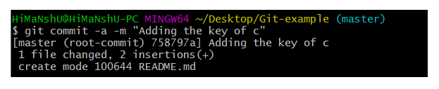
Syntax
To add one file
$ git add Filename
To add more than one file
$ git add*
5. GIT COMMIT COMMAND
This command changes the head. It records or snapshots the file permanently in the version history with a message.
Syntax
$ git commit -m " Commit Message"
Git commit -a
This command commits any files added in the repository with git add and also commits any files changed since then.
Syntax
$ git commit -a

Slide 14
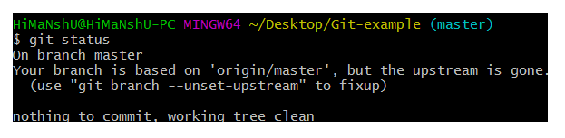
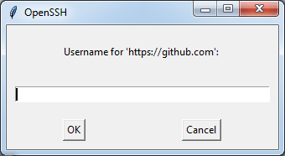
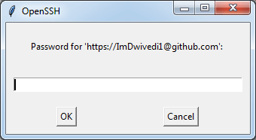
6) Git status command
The status command is used to display the state of the working directory and the staging area. It does not show you any information about the committed project history.
Syntax
$ git status
7) Git push Command
It is used to upload local repository content to a remote repository.
It's the complement to git fetch, but whereas fetching imports commits to local branches on comparatively pushing exports commits to remote branches
SYNTAX
$ git push [variable name] master

Slide 15

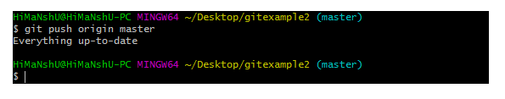
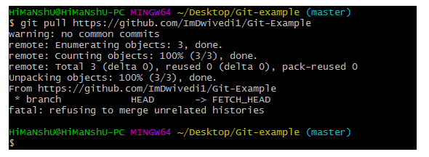
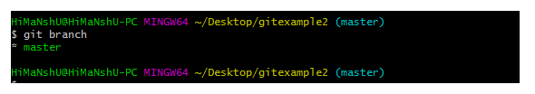
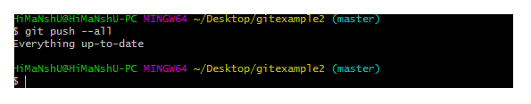
Git push -all
This command pushes all the branches to
the server repository.
Syntax
$ git push --all
8) Git pull command
Pull command is used to receive data from GitHub. It fetches and merges changes on the remote server to your working directory.
Syntax
$ git pull URL
9) Git Branch Command
This command lists all the branches available in the repository.
Syntax
$ git branch

Slide 16

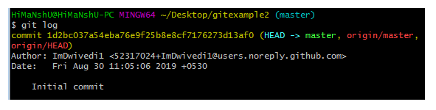

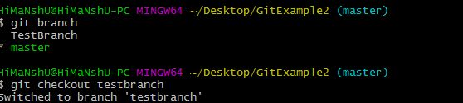
10) Git Merge Command
This command is used to merge the specified branch?s history into the current branch.
Syntax
$ git merge BranchName
11) Git log Command
This command is used to check the commit history.
Syntax
$ git log
12) Git remote Command
Git Remote command is used to connect your local repository to the remote server.
13)Git Checkout
In Git, the term checkout is used for the act of switching between different versions of a target entity.
Syntax:
$ git checkout <branchname>

Slide 17
ADDING README.MD FILE
A ReadMe file is a standard place for instructions or documentation that you want to share with people about a repo.
1. Create a file named README.md in the root (based) folder of the Git repo.
2. Add any instructions or documentation that you want to share with others.
3. When done, commit the changes and push them to the remote repo.

Slide 18
GETTING UP REPOSITORY
Git repository in local machine can be obtained in one of two ways:
Take a local directory that is currently not under version control, and turn it into a Git repository, or
You can clone an existing Git repository from elsewhere.
Initializing a Repository in an Existing Directory
For Linux:
$ cd /home/user/my_project
for macOS:
$ cd /Users/user/my_project
for Windows:
$ cd C:/Users/user/my_project
and type:
$ git init
GIT CLONE
Every version of every file for the history of the project is pulled down –git clone command
SYNTAX
git clone <url>

Slide 19
CREATING REPOSITORY
The clone command will create a directory named libgit2, initializes a .git directory inside it, pulls down all the data for that repository, and checks out a working copy of the latest version
$ git clone https://github.com/libgit2/libgit2
The cloned repository can also be save into a new directory
$ git clone https://github.com/libgit2/libgit2 mylibgit
Mylibgit-target directory

Slide 20
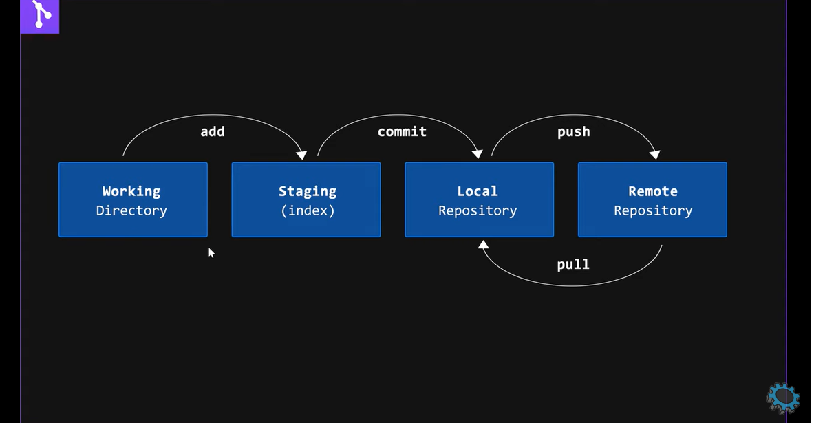
To Create Local Repository in GIT
Step 1: $ cd c:\localhost
Step 2 : $ mkdir my-new-repository
Step 3: $ cd my-new-repository
Step 4: $ git init
Step 5: $ touch my-new-filename.text
(Creating a new file in the repository)
Step 6 : $ git status

Slide 21
Step 6: $ git add my-new-filename.txt
Step 7: $ git status
Step 8: $ git commit –m ”create a new file my-new-filename.txt” (commit the changes to the local repository)
Step 9: $ git log(to see the file added)
Step 10: $ git checkout –b “my-new-branch” (create a new branch. Branch is adding feature without affecting the main project
Step 11: $ git branch(to see which branch we are in )
Step 12: $ touch myfile-branched.txt (create a new file in the new branch)
Step 13: $ git add myfile-brancehed.txt(add the file to the new branch)
Step 14: $ git commit –m “Create a new file mufile-branched.txt”
Step 15: $ git status
Step 16 : $ git log (changes shows the log history)
Merge the new branched file with the master file
Step 17: $ git checkout
Step 18: $ git branch
Step 19: $ git merge my-new-branch(merged the changes to the main file)

Slide 22
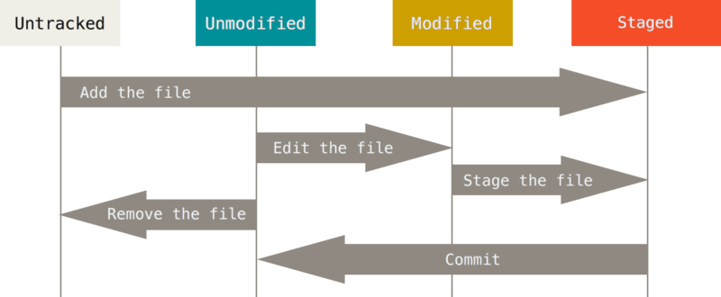
Recording Changes to the Repository
File in working directory can be in one of two states: tracked or untracked.
Tracked files are files that were in the last snapshot, as well as any newly staged files; they can be unmodified, modified, or staged. Tracked files are files that Git knows about.
Untracked files are everything else — any files in your working directory that were not in your last snapshot and are not in your staging area. When you first clone a repository, all of your files will be tracked and unmodified because Git just checked them out and you haven’t edited anything.As you edit files, Git sees them as modified, because you’ve changed them since your last commit. As you work, you selectively stage these modified files and then commit all those staged changes, and the cycle repeats.

Slide 23
Viewing commit history
Git log command: git log lists the commits made in that repository in reverse chronological order
options
1.A patch is a text file whose contents are similar to Git diff but along with code it contains metadata about commits, for example, a patch file will include commit ID, date, commit message, etc.
Options –p or –patch can be used in log command
Ex: $git log –p -2
// list only last two enteries
2. --stat
option prints below each commit entry a list of modified files, how many files were changed, and how many lines in those files were added and removed. It also puts a summary of the information at the end.
3.– pretty
This option changes the log output to formats other than the default.
Value to the –pretty option
The oneline value for this option prints each commit on a single line.
short, full, and fuller values show the output in roughly the same format but with less or more information,

Slide 24
Format which allows you to specify your own log output format.
Ex;
$ git log --pretty=format:"%h - %an, %ar : %s" ca82a6d - Scott Chacon, 6 years ago : Change version number 085bb3b - Scott Chacon, 6 years ago : Remove unnecessary test a11bef0 - Scott Chacon, 6 years ago : Initial commit
Specifier | Description of Output
%H | Commit hash
%h | Abbreviated commit hash
%T | Tree hash
%t | Abbreviated tree hash
%P | Parent hashes
%p | Abbreviated parent hashes
%an | Author name
%ae | Author email
%ad | Author date (format respects the --date=option)
%ar | Author date, relative
%cn | Committer name
%ce | Committer email
%cd | Committer date
%cr | Committer date, relative
%s | Subject

Slide 25
Option | Description
-p | Show the patch introduced with each commit.
--stat | Show statistics for files modified in each commit.
--shortstat | Display only the changed/insertions/deletions line from the --stat command.
--name-only | Show the list of files modified after the commit information.
--name-status | Show the list of files affected with added/modified/deleted information as well.
--abbrev-commit | Show only the first few characters of the SHA-1 checksum instead of all 40.
--relative-date | Display the date in a relative format (for example, “2 weeks ago”) instead of using the full date format.
--graph | Display an ASCII graph of the branch and merge history beside the log output.
--pretty | Show commits in an alternate format. Option values include oneline, short, full, fuller, and format (where you specify your own format).
--oneline | Shorthand for --pretty=oneline --abbrev-commit used together.

Slide 26
Option | Description
-<n> | Show only the last n commits
--since, --after | Limit the commits to those made after the specified date.
--until, --before | Limit the commits to those made before the specified date.
--author | Only show commits in which the author entry matches the specified string.
--committer | Only show commits in which the committer entry matches the specified string.
--grep | Only show commits with a commit message containing the string
-S | Only show commits adding or removing code matching the string

Slide 27
UNDOING THINGS
One of the common undos takes place when you commit too early and possibly forget to add some files, or you mess up your commit message. If you want to redo that commit, make the additional changes you forgot, stage them, and commit again using the --amend option:
$ git commit --amend
Unstaging a Staged File
git reset HEAD <file> OR git restore
Unmodifying a Modified File
git restore

Slide 28
Working with Remotes
Remote repositories are versions of your project that are hosted on the Internet or network somewhere.
To see which remote servers you have configured, you can run the git remote command.
You can also specify -v, which shows you the URLs that Git has stored for the shortname to be used when reading and writing to that remote:
EXAMPLE
$ git remote –v
backdoor https://github.com/bakkdoor/grit (fetch)
bakkdoor https://github.com/bakkdoor/grit (push)
Cho45 https://github.com/cho45/grit (fetch)
To add remote repositories git remote add <shortname> <url>

Slide 29
Fetching and Pulling from Your Remotes
git fetch command only downloads the data to your local repository — it doesn’t automatically merge it with any of your work or modify what you’re currently working on. You have to merge it manually into your work when you’re ready.
$ git fetch <remote>
git pull command to automatically fetch and then merge that remote branch into your current branch
Pushing to Remotes
When you have your project at a point that you want to share, you have to push it upstream. The command for this is simple: git push <remote> <branch>
Inspecting a Remote
If you want to see more information about a particular remote, you can use the git remote show <remote> command.
Ex $git remote show origin
Renaming and Removing Remotes
You can run git remote rename to change a remote’s shortname
$ git remote rename pb paul
$ git remote remove
$ git remote rm:

Slide 30
Tagging
Listing Your Tags
Git has the ability to tag specific points in a repository’s history as being important.
Example
$ git tag
v1.0
v2.0
You can also search for tags that match a particular pattern.
Example
$ git tag -l "v1.8.5*“
v1.8.5
v1.8.5-rc0
v1.8.5-rc1
v1.8.5-rc2
v1.8.5-rc3
v1.8.5.1

Slide 31
Creating Tags
Git supports two types of tags: lightweight and annotated.
Annotated Tags
Annotated tags are stored as full objects in the Git database. They’re checksummed; contain the tagger name, email, and date; have a tagging message; and can be signed and verified with GNU Privacy Guard (GPG)
Example
$ git tag -a v1.4 -m "my version 1.4"
Lightweight Tags
Another way to tag commits is with a lightweight tag
Ex:$ git tag v1.4-lw
Tagging Later
Tagging of commits can also be done after moved on
Ex $ git tag -a v1.2 9fceb02

Slide 32
Sharing Tags
By default, the git push command doesn’t transfer tags to remote servers. It will have to explicitly push tags to a shared server after created them. This process is just like sharing remote branches — you can run git push origin <tagname>.
Deleting Tags
To delete a tag on your local repository, you can use git tag -d <tagname>
There are two common variations for deleting a tag from a remote server.
The first variation is
$git push <remote> :refs/tags/<tagname>
The second (and more intuitive) way to delete a remote tag is with:
$ git push origin --delete <tagname>
Checking out Tags
If you want to view the versions of files a tag is pointing to, you can do a git checkout of that tag,

Slide 33
Git Aliases
Git doesn’t automatically infer your command if you type it in partially.
If you don’t want to type the entire text of each of the Git commands,
you can easily set up an alias for each command using
git config.
$ git config --global alias.co checkout
$ git config --global alias.br branch
$ git config --global alias.ci commit
$ git config --global alias.st status

Slide 34
THANK YOU

